Slide 1
AOA Rheumatology Review

Slide 2
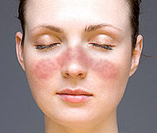
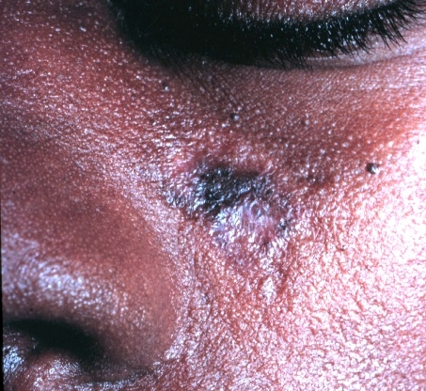
Case #1:
A 33 year old woman presents to her doctor with a rash on her face, fever, joint pain and joint swelling in hands,wrists, ankles and knees, easy bruising, and fatigue. After a full h and P, what tests do you want to order?

Slide 3
Tests
CBC with Diff
CMP- evaluate for renal disease
UA- look for protein in urine
ANA- sensitive, but not specific
If + ANA- reflex tests
anti-dsDNA antibody- indication of disease activity
anti-Smith- indicator of kidney disease
SSA and SSB
Anti coagulant antibodies- Prolonged PTT

Slide 4
Reasons for an ANA Positive test
Other autoimmune disease
Normal variant
Medications associated with Drug induced lupus
Procainamide
Quinidine
Hydralazine
Phenytoin
Anti- histone antibodies in Drug induced.

Slide 5
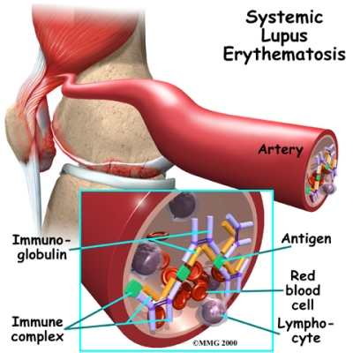
SLE
More common in women especially reproductive age
Type III hypersensitivity (immune complex) reactions
Some Type II ( Anemia)
( T cell mediated)
Abnormalities in cell apoptosis – increased expression of FAS by T cells and B cells

Slide 6
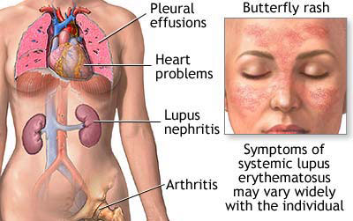

Slide 7
“SOAP BRAIN MD”- 4/11 for Diagnosis
Serositis - Pleurisy, pericarditis on examination or diagnostic ECG or imaging
Oral ulcers - Oral or nasopharyngeal, usually painless; palate is most specific
Arthritis – Non-erosive, two or more peripheral joints with tenderness or swelling
Photosensitivity - Unusual skin reaction to light exposure

Slide 8
“SOAP BRAIN MD”- 4/11 for Diagnosis
Blood disorders –
Leukopenia, lymphopenia, thrombocytopenia (in the absence of offending medications), hemolytic anemia
Renal involvement –
Proteinuria (>0.5 g/d or 3+ positive on dipstick testing) or cellular casts
ANAs –Higher titers generally more specific (>1:160); in the absence of medications associated with drug-induced lupus

Slide 9
“SOAP BRAIN MD”- 4/11 for Diagnosis
Immunologic phenomena-
dsDNA; anti-Smith (Sm) antibodies; antiphospholipid antibodies anticardiolipin immunoglobulin G [IgG] or immunoglobulin M [IgM] or lupus anticoagulant); biologic false-positive serologic test results for syphilis
Neurologic disorder –
Seizures or psychosis in the absence of other causes

Slide 10
SOAP BRAIN MD 4/11
Malar rash - Fixed erythema over the cheeks and nasal bridge, flat or raised
Discoid rash - Erythematous raised-rimmed lesions with keratotic scaling and follicular plugging, often scarring

Slide 11
Treatment: Symptomatic
NSAIDs or other pain meds
Avoid sunlight, and dietary changes
Disease modifying anti-rheumatic drugs (DMARD)-
Corticosteroids
Methotrexate
Azathioprine
HydroxyChloroquinolone- cutaneous flares
Cyclophosphamide- severe renal
Complication: hemorrhagic cystitis

Slide 12
Renal disease- Lupus nephritis
Typically wire loop lesions, but can be all types of renal disease
Proteinuria or hematuria
Can progress to ESRD and require transplant
30% of transplanted patients lupus nephritis reoccurs.

Slide 13
Pregnant Women with SLE
SSB and SSA antibodies are associated with Congenital Heart block.

Slide 14
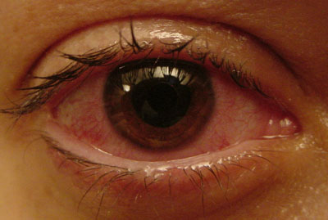
Case 2
20 year old male with pain in his lower back, and stiffness which improves with physical activity, a new heart murmur, and bilateral eye inflammation. He denies any recent GI symptoms and has never been sexually active.

Slide 15
Xray of spine and SI joints

Slide 16
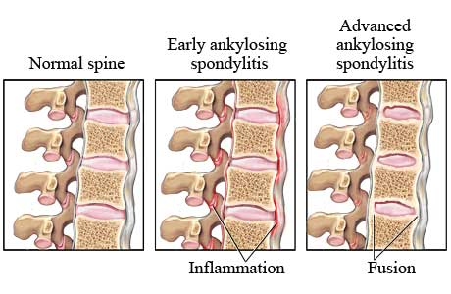

Slide 17
Ankylosing Spondilitis
Males 15 to 35 years old
Seronegative Spondyloarthropathy
Rheumatoid Factor Negative
HLA B 27 associated in >90%
Spine and sacroilliac joints can involve knees
Uvetitis, aortitis with Aortic regurgitation
Other associations:
ANCA – positive, but does not correlate with severity
Apical lung fibrosis and restrictive lung disease

Slide 18
Treatment
Physical therapy
Exercise
NSAIDs
DMARDs- steroids, methotrexate
TNF alpha inhibitors
Rarely Surgery

Slide 19
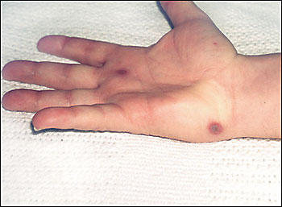
Case 3
24 year old man with 4 days of right knee and left wrist pain and swelling. He has also noticed a painful, non-pruritic papular rash on his palms although a few of the lesions have started bleeding. What else would you ask?
What should you do?

Slide 20
Ask a sexual history
Get a throat culture and urethra culture
Painful inflamed joint?
ALWAYS rule out a septic joint.

Slide 21
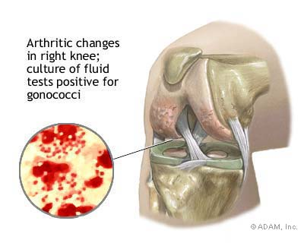
TAP the KNEE!

Slide 22
Gonococcal arthritis
Women more than men
Triad : dermatitis, tenosynovitis, and asymmetric migratory polyarthritis

Slide 23
Case 4
73 year old, obese female with right hip pain. She fell on her hip several years ago and it has hurt since. It is worse when walks, and better with rest. Her range of motion on physical exam is decreased, the hip is tender to touch and she says it is stiff. She has no rashes, no fever, and no other joints are bothering her.
What is your next step?

Slide 24
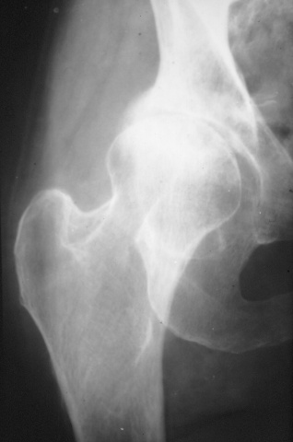
Get an X-ray!

Slide 25
4 classic findings on Xray for OA
Joint space narrowing
Marginal osteophytes
Sclerotic joint margins
Subchondral cysts

Slide 26
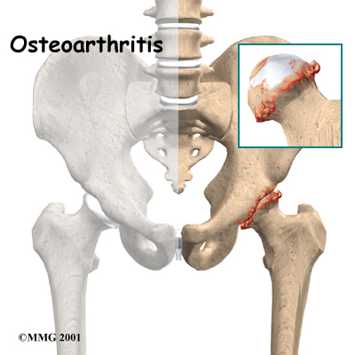
What is going on in the joint?
Cartilage is wears down, Bone on bone
New bone growth- osteophytes are stimulated.
Restricts motion and causes pain

Slide 27
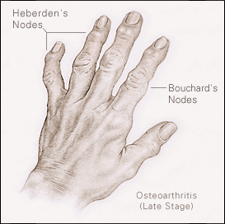

Slide 28
Osteoarthritis or DJD
"wear and tear"
Factors
aging
injury
Obesity ( 2ndary OA) – INCREASED STRESS ON JOINT
Joint stiffness, pain, and decreased range of motion
Usually affects weight-bearing joints (i.e., back, hip, knee) as well as the neck, small finger joints and big toe
Tends to get worse with activity throughout the day
middle aged and older people

Slide 29
Treatment- does not CURE!
Mild
Rest – no repetitive motion
Exercise as tolerated
Lose weight- decreases stress on joint
. Physical therapy, cold/heat compresses, OTC cremes
Moderate: Add Medications
Tylenol for pain
NSAIDs if no contraindications
Tramadol
Severe
Stronger pain medications
Cortisone and Visco- supplementation
Joint Replacement

Slide 30
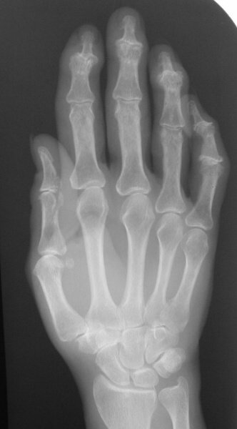
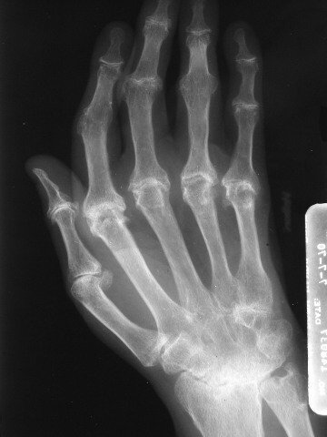
Osteoarthritis vs. Rheumatoid Arthritis

Slide 31
Case 5
30 year old women complains of pain in her wrists, fevers periodically, swelling and stiffness in both ankles, and loss of energy. She says that she feels horrible in the morning and as she moves more she feels better. PMH was significant for a normal pregnancy last year. Otherwise healthy. No history of trauma to any joints. Physical exam: Febrile, nodules on her elbows, ankles and wrists are edematous, warm, and tender with decreased range of motion.

Slide 32
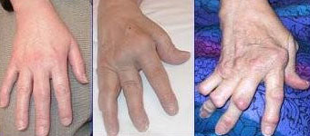
Hands of the Patient
ulnar deviation, boutonniere deformity, swan neck deformity and "Z-thumb"

Slide 33
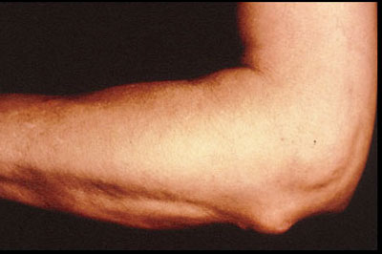
Rheumatoid Nodules
Nodules are areas of fibrinoid necrosis.
Kaplan syndrome= rheumatoid nodule of the lung and pneumoconosis ( Silicosis, asbestosis, and coal miner’s disease)

Slide 34
Extraarticular Manifestations
Hematologic – Anemia- most common, thrombocytosis, or Neutropenia-(with Felty’s syndrome- RA, neutropnenia, enlarged liver/spleen)
Neurologic- peripheral neuropathy, mononeuritis multiplex, leading commonly to carpal tunnel syndrome and rarely atlanto-axial subluxation
Ocular- episcleritis
Hepatic- increased cytokine production by Kupffer Cells, ( increased CRP) , Felty syndrome- nodular sclerosis- enlargement

Slide 35
Diagnostic Criteria for RA >4
Morning stiffness of >1 hour most mornings for at least 6 weeks.
Arthritis and soft-tissue swelling of >3 of 14 joints/joint groups, present for at least 6 weeks
Arthritis of hand joints, present for at least 6 weeks
Symmetric arthritis, present for at least 6 weeks
Subcutaneous nodules in specific places
Rheumatoid factor at a level above the 95th percentile (Note:a negative RF does not rule out disease because especially during first year of illness may be negative) only 80% with RA have +RF.
Radiological changes suggestive of joint erosion

Slide 36
Pathology of RA
An Inappropriate immune response occurs and plasma cells make Ig M and IgG antibodies to citrullinated peptides (ACPA) and RF Ig M against ___________.
Macrophages activated through Fc receptor and complement causing the inflammatory response with TNF alpha and IL- 1.
Inflamming the synovium, edema develops, and vasodilation allows T cells to aggregate.

Slide 37
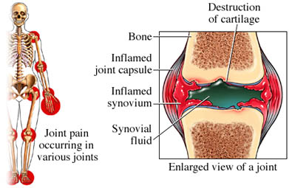
Pathology of RA
Synovial macrophages and dendritic cells (as antigen presenting cells) by expressing MHC class II molecules,-> local immune reaction
Formation of granulation tissue at the edges of the synovial lining (pannus)
Angiogenesis and production of enzymes cause tissue damage.
Synovium thickens and cartilage and bone is damaged destroying the joint.

Slide 38
Treat Early - Joint damage from RA can begin to occur within the first 12 mo.
Symptomatic - Anti-inflammatories and analgesics improve pain and stiffness but do not prevent joint damage or slow the disease progression.

Slide 39
Prevent Destruction – DMARDs
Chemically synthesised : azathioprine , ciclosporin (cyclosporine A) , D-penicillamine , gold salts, hydroxychloroquine , leflunomide , methotrexate (MTX) , minocycline , sulfasalazine (SSZ)
Cytotoxic drugs: Cyclophosphamide
Biological agents (biologics) :tumor necrosis factor alpha (TNFα) blockers - etanercept (Enbrel), infliximab (Remicade), adalimumab (Humira) Interleukin 1 (IL-1) blockers - anakinra (Kineret) monoclonal antibodies against B cells - rituximab (Rituxan)^{[25]} T cell costimulation blocker - abatacept (Orencia) Interleukin 6 (IL-6) blockers - tocilizumab (an anti-IL-6 receptor antibody) (RoActemra, Actemra)

Slide 40
Seronegative Spondyloarthropathy
Types include:
ankylosing spondylitis
psoriatic arthritis
Reiter's disease and enteropathic spondylitis
undifferentiated spondyloarthropathy

Slide 41
Seronegative Spondyloarthropathy
They are in relation to HLA-B27
sacroiliitis and spondylitis are present in them.
Polyarthritis of large joints
familial aggregation occurs
Overlap is likely in them
rheumatoid factor is not present

Slide 42
Reactive Arthritis
Preceding Infection
GU- Chlamydia, Gonorrhea, Ureaplasma
GI- Salmonella, Shigella, Yersinia, Campylobacter
Arthritis- 1-3 weeks later
Culture the throat, cervix, and urethra and get stool studies
Synovial Cultures- negative
Possible autoimmune response / bacterial antigens in joints

Slide 43
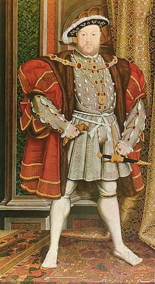
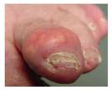
Case 6
King Henry the VIII who overweight, probably diabetic and hypertensive, who just drank all night and ate a large meal complains of a pain that suddenly woke him up at night in his big toe. He tries to kick you when you examine his toe and howls in pain.

Slide 44
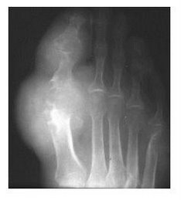
After an H and P,
Get an X-ray
Tap the Joint!
Always have to consider a painful, inflamed joint infected until proven otherwise.
Do you expect an abnormal uric acid level?

Slide 45
Under polarized light you see? Blue spikes.

Slide 47
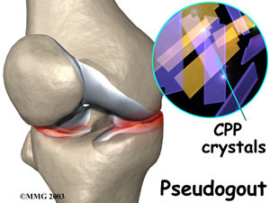
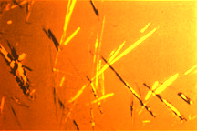
Pseudogout
Caused by calcium pyrophosphate crystals deposited in the joint space.
Usually knee, ankle, or wrist, or several joints
Commonly involves shoulder, gout does not.
They are Positively bifringent and rhomboid shaped.

Slide 48
Treatment
Gout
Pain Medication- NSAIDs, acetaminophen, opiates, etc.
Allopurinol – mechanism?
Colchine- Mechanism?
Probenicid- Mechanism?
Corticosteroids
NSAIDs and Colchine acute attacks
Probenicid and allopurinol- prevention

Slide 49
Cancer patient undergoing chemo?
Tumor lysis syndrome
Lots of cell turnover, increased DNA destruction, increased uric acid
Gout
Prophylaxis: allopurinol during chemo tx

Slide 50
Pseudogout treatment
intra-articular corticosteroid injection
systemic corticosteroids
non-steroidal anti-inflammatory drugs (NSAIDs)

Slide 51
Scleroderma
CREST syndrome- calcinosis, raynaud’s, esophageal dysmotility,sclerodactyly telectangias
Diffuse- worse because can cause heart irregular rhythms and failure
Treatment: Symptomatic-
CCBs for Raynauds
Immune suppressants: Steroids, MTX, cyclophosphomide etc.

Slide 52
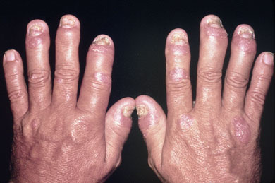
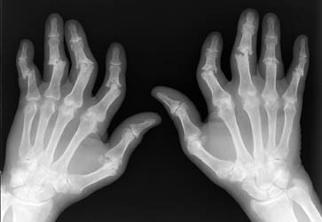
Psoriatic Arthritis

Slide 54
Takaysou’s arteritis
Granulomatous arteritis of aortic arch
Lumen narrowed due to intima thickening
Decreased pulses in neck and arms = pulseless arteritis
Young asian females with vision problems and neurologic changes

Slide 55
Temporal arteritis= Giant cell arteritis
Affect external carotid especially the temporal artery and potentially ophthalmic artery-> blindness if not treated
Pain, palpable artery, and pulsation and pain with chewing
Vision changes, ESR > 100,
Polymyalgia rheumatica- shoulder and hip girdle aches in 50% cases,( not vice versa)
Treat with prednisone 60mg before biopsy
Biopsy: See granulomas in media

Slide 56
Wegener’s
Classically pt with hemoptysis and kidney disease
Necrotizing granulomas in the small and medium vessels
C- ANCA- Wegener’s, assoc. with Hepatitis C

Slide 57
Polyarteritis Nodosa
Small and medium sized arteries anywhere in body
Acute and chronic inflammation
Renal or mesenteric most commonly
various symptoms: Systemic symptoms, abd pain, cresecentic GN
P- ANCA= Polyarteritis
33% of Pt with PAN have Hep B
Tx with Corticosteroids and cyclophosomide

Slide 58
Microscopic polyangitis
Small vessel vasculitis
Palpable purpura
Type III hypersensitivity reaction
Associated with drugs, infection, and neoplasms.

Slide 59
Thromboangitis obliterans- Buerger’s disease
Small and large vessel disease- tibial and radial arteries most commonly
Segmental thrombosisng acute and chronic inflammation
Smoker in 30s to 40s with cold, blue toes, hands due to thrombosis.

Slide 60
Polymyositis vs. Dermatomyositis
No rash vs. Rash ( purple eye shadow- heliotrope rash)
Location of inflammation is different
Polymyositis -Chronic infiltrates in muscles of CD 8 lymphocytes
Dermatomyositis- vasculitis of capillaries causing hypoperfusion and muscle fiber atrophy
Association with visceral cancer in dermatomyositis
Association with Anti- Jo1 in Polymyositis

